Slide 1
Final Project Analyzing the prices of QQQ, IWM, and SPY around US Unemployment Rate announcements.
By Massa Coulibaly

Slide 2
Outline
Problem Statement
Literature Review
Data description & Exploratory Data Analysis
Methodology
Findings
Conclusion

Slide 3
Problem Statement
IWM - iShares Russell 2000 ETF
Tracks the Russell 2000 index, which represents the performance of approximately 2000 small-cap companies in the U.S. stock market. (NOVAVX, Revolve Group Inc…)
SPY - SPDR S&P 500 ETF Trust
Aims to provide investment results that correspond generally to the price and yield performance of the S&P 500 Index for 500 companies. (JNJ, ExxonMobill…)
QQQ - Invesco QQQ Trust
Replicates the NASDAQ-100 Index, which includes 100 of the largest non-financial companies listed on the NASDAQ stock market. Focuses on tech companies and Bio-tech( APL, AMZN…)
US unemployment Rate Announcement
The unemployment rate represents the percentage of the labor force that is jobless and actively seeking employment. It is a key indicator of economic health.
Problem statement
How does the US unemployment rate announcement affect the performance of IWM, SPY and QQQ?

Slide 4
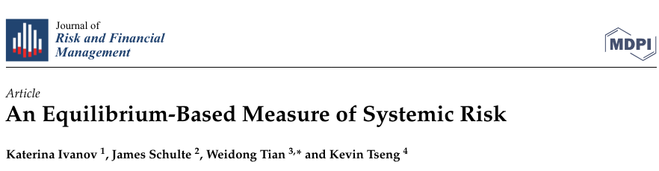
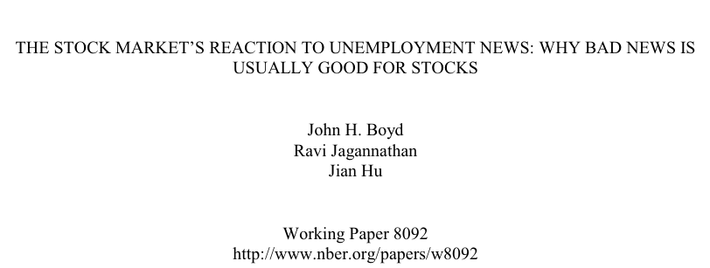
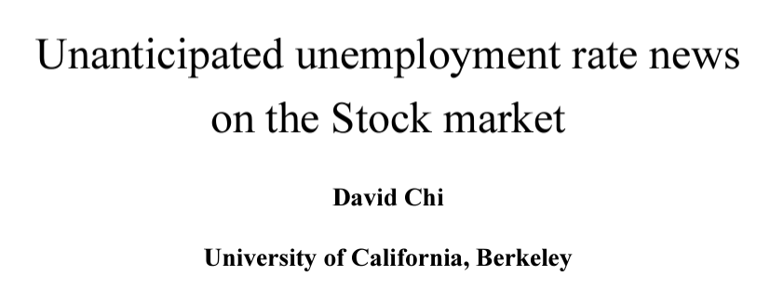
Literature Review
Objective of the Study: Investigate the impact of economic indicators, specifically U.S. unemployment rate announcements, on the stability of the stock market and identify systemic risks associated with too-big-to-fail (TBTF) banks
Methodology: Equilibrium model that integrates unemployment rate data to assess its direct and indirect effects on stock market volatility and the systemic risk posed by large financial institutions.
Key Findings: Unemployment announcements significantly influence stock market responses, particularly through their impact on large financial institutions labeled as TBTF.
Objective of the Study: The short-term response of stock prices to U.S. unemployment rate announcements.
Methodology: Historical unemployment data, primarily focusing on the Bureau of Labor Statistics' monthly unemployment announcements from 1948 to 1995.
It employs time-series models to predict the unemployment rate and its unanticipated component, assessing the impact on stock and bond prices.
Key Findings: Stock markets typically react positively to rising unemployment during economic expansions due to anticipated cuts in interest rates, and negatively during contractions due to deteriorating growth expectations.
Objective of the Study: This paper explores the impact of unexpected unemployment rates on the stock market, utilizing macroeconomic models to understand the influence of labor market conditions on stock prices.
Methodology: The study employs a combination of econometric analysis and event study methodology to assess the reaction of stock prices to news about unemployment rates, considering other economic indicators and news.
Key Findings: The research identifies significant reactions in stock prices to unexpected changes in unemployment rates, highlighting the stock market's sensitivity to economic indicators and the broader implications for investors and policymakers.

Slide 5
Data description & Exploratory Data Analysis

Slide 6
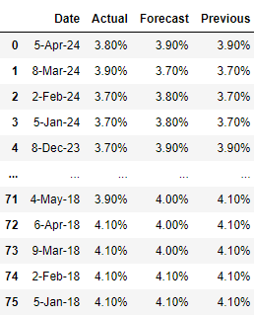
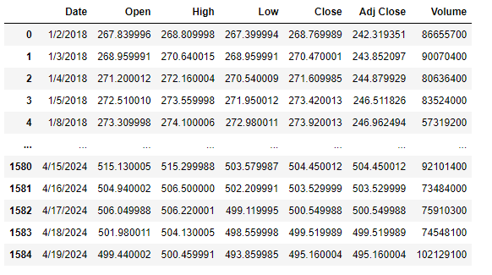
Data description
Unemployment Rate
SPY, IWM, QQQ
Source: ForexFactory
Timeframe: 2018 – 2024
CSV file, Once a month anouncement.
Source: Yahoo Finance
Timeframe: 2018 – 2024
CSV file, daily

Slide 7
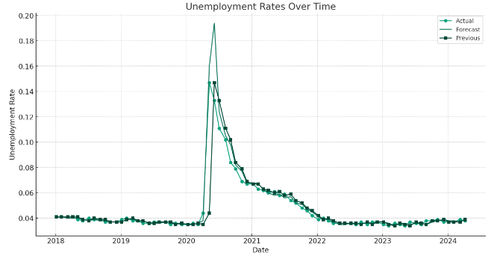
Exploratory Data Analysis
Unemployment rates

Slide 8
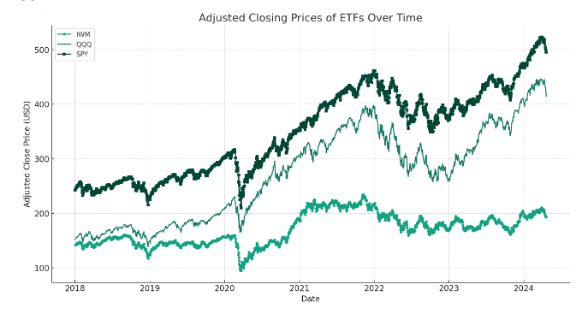
Exploratory Data Analysis
ETFs

Slide 9
Methodology

Slide 10
Steps in the event study
1. Objective
To assess the impact of unemployment rate announcements on the stock prices of major ETFs.
2. Dataset Description
- Daily trading data for ETFs: SPY (S&P 500 ETF), QQQ (Nasdaq-100 ETF), and IWM (Russell 2000 ETF).
- Unemployment rate announcements including actual, forecast, and previous figures.
3. Estimation Window
- A 30-day period prior to the start of the event window
4.Event Definition
- Identify the days on which unemployment rates were announced (termed as "Announcement Days").
5. Event Window
- A 5-day window centered around the announcement day (2 days before, the day of, and 2 days after the announcement).
6. Calculation of Normal Returns
- The mean return during the estimation window
6. Calculation of Actual Returns
- Daily returns for each ETF calculated for the days within the event window.
7. Abnormal Returns
- The difference between the actual returns during the event window and the normal returns.

Slide 11
Findings

Slide 12
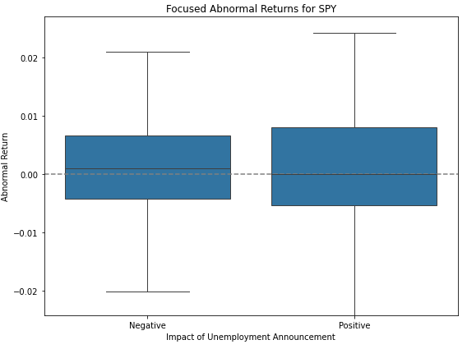
SPY
Positive Announcements: The distribution of abnormal returns is more concentrated around zero, suggesting minimal reaction when the actual unemployment rate is below the forecast. This implies that positive news may already be somewhat anticipated or factored into prices.
Negative Announcements: There's slightly increased variability in returns compared to positive announcements, indicating a more significant reaction when the actual unemployment rate exceeds the forecast. This suggests concerns or negative sentiment regarding economic health, which affects the broader market represented by SPY.

Slide 13
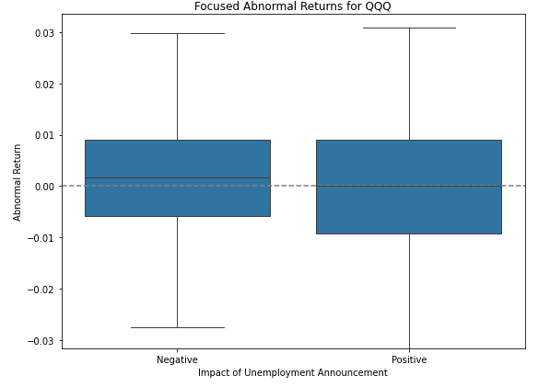
QQQ
Positive Announcements: Similar to SPY, the returns are tightly grouped near zero, but with a slight positive skew. This could indicate that tech-heavy indices like the Nasdaq-100 might respond slightly more positively to better-than-expected economic news.
Negative Announcements: Displays a wider spread in abnormal returns, showing that negative news impacts this ETF more substantially. The tech sector might be more sensitive to economic downturns, or investor sentiment in this sector could be more volatile.

Slide 14
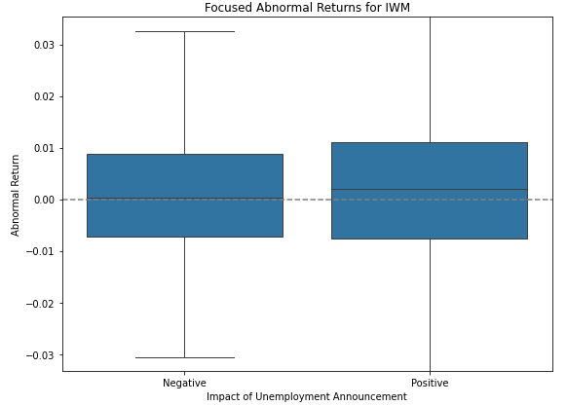
IWM
Positive Announcements: Shows a broader spread in returns, similar to the other ETFs, but with some more extreme outliers. This suggests that small-cap stocks might be more vulnerable to negative economic news, likely due to the perceived higher risk associated with smaller companies during economic downturns.
Negative Announcements: The median return is close to zero, with a relatively narrow interquartile range. This indicates a moderate reaction to positive economic news, possibly due to the diverse nature of the small-cap companies in the Russell 2000, which might not be as sensitive to macroeconomic changes as larger companies.

Slide 15
Conclusion
The unemployment rate announcements do impact ETFs, with negative announcements generally leading to higher volatility in ETF prices. This suggests that market participants react more strongly when the actual unemployment rate exceeds forecasts, potentially due to concerns about economic health and stability.

Slide 16
References
Ivanov K, Schulte J, Tian W, Tseng K. An Equilibrium-Based Measure of Systemic Risk. Journal of Risk and Financial Management. 2021; 14(9):414. https://doi.org/10.3390/jrfm14090414
Chen Gu, Denghui Chen, Raluca Stan, Resolution of financial market uncertainty around the release of unemployment rate announcements, International Review of Economics & Finance, Volume 80, 2022, Pages 586-596, ISSN 1059-0560, https://doi.org/10.1016/j.iref.2022.02.077
Mark J. Holmes, Nabil Maghrebi, Financial market impact on the real economy: An assessment of asymmetries and volatility linkages between the stock market and unemployment rate, The Journal of Economic Asymmetries, Volume 13, 2016, Pages 1-7, ISSN 1703-4949, https://doi.org/10.1016/j.jeca.2015.10.003
Gonzalo, Jesús and Taamouti, Abderrahim. "The reaction of stock market returns to unemployment" Studies in Nonlinear Dynamics & Econometrics, vol. 21, no. 4, 2017, pp. 20150078. https://doi.org/10.1515/snde-2015-0078
Prakash Loungani, Mark Rush, William Tave, Stock market dispersion and unemployment, Journal of Monetary Economics, Volume 25, Issue 3, 1990, Pages 367-388, ISSN 0304-3932, https://doi.org/10.1016/0304-3932(90)90059-D

Slide 17
Thank you!

